Slide 1

Building a local facet in Primo VE for Decolonization work
EPUG AGM Monday 16th October 2023 Jill Hazard

Slide 2
Background
Sheffield Hallam University (SHU)
  Alma and Primo since 2015, Primo VE since 2017
  We refer to Primo/Primo VE as ‘Library Search’
Me
  Worked with Systems and Service Development since 2019
  Worked at SHU since 2009, my background at SHU is in Metadata

Slide 3
How it started
“Is it possible to add ‘publisher/place of publication’ into Library Search as something we can use in the search?”
Notes:
With a very simple and short (paraphrased) question from the
Learning and Teaching Librarian in charge of decolonisation (who are our student and academic support librarians).

Slide 4
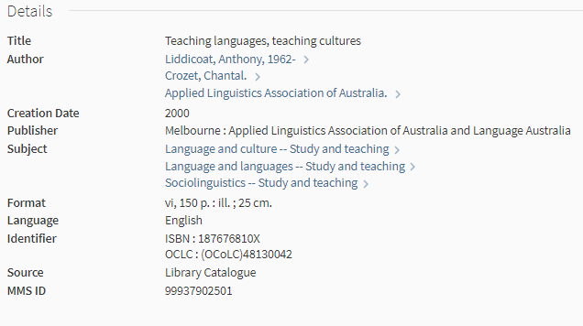
Starting point for a non-cataloguer
Suggestions :
Advanced search filter/field selector
Using the 260/264 MARC fields
Notes:
The query didn’t start with me, those people passing it on suggested
Advanced search,
place of publication information you see in the catalogue record
as that is what they see as being available to use as data with it being an understandable and visible fields in the records that could be used.

Slide 5
Why we didn’t do that
Sheffield
Sheffield, S. Yorks
Sheffield, South Yorkshire
Sheffield, UK
Sheffield, England
Notes:
The examples you see here, are what you could find in 260 and 264 fields in MARC
is entered in verbatim from the source, so depending on how the publisher has put in the information,
too much variety in entry

Slide 6
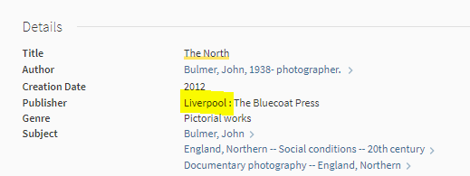
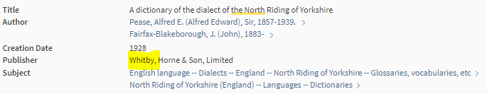

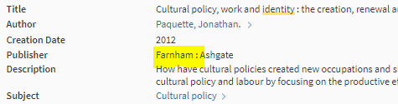
Also
Notes:
Too much granularity and specificity - This is for decolonization so surely not this level.
Fundamentally, this doesn’t make for easily machine readable and collatable data
... however as a former cataloguer I know what does and i know what else is in a MARC record....

Slide 7
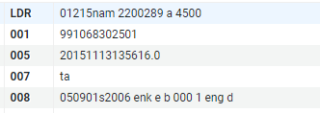
Starting point for a cataloguer
008 pos. 15-17
Notes:
What make MARC records Machine Readable Records lies in their fixed field data.
the place of publication is also stored in in the 008 fixed field at positing 15-17.
Unlike other elements of the 008 field, this doesn’t change depending on the material type, book or bluray, the position and information is the same in all MARC records.
Now we just need to figure out how to use that in Primo and for it to display in a non-coded way.
At the same time as figuring this out I went back to the Library Learning and Teaching librarian who originally asked for it ... from speaking directly it sounds like they would actually like a facet

Slide 8

How to create a dynamic facet in Primo VE
FACET!
Notes:
I had established that we would need to use a local field for facet however looking through the documentation it mainly took locally created fields (500 and 900 fields) and not an option for 008, meaning that this wasn’t standard practice, but at time point i had no idea how to build normalization rules or what regular expressions were, However after seeing a paper presented at IGELU 2022, where it was mentioned in passing that they had created a place of publication facet/filter, i knew it was possible.
It’s much easier to know how to look for information and ways of doing something once you have a clearer idea of how you want it to work. having a better idea means that we could research in a more focused way and find things we could use.
more research led me to instructions on the Ex Libris site for How to create a dynamic facet in Primo VE

Slide 9
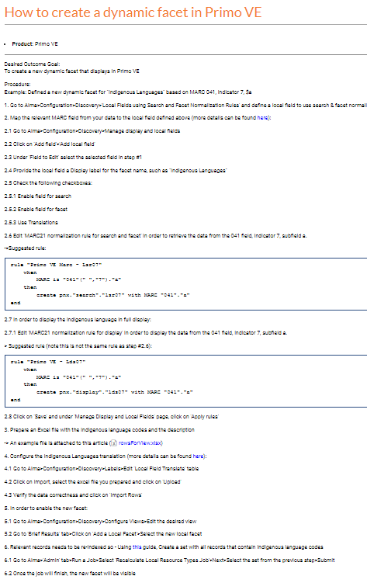
Steps to build
Add a field to Local Fields Using Search and Facet Normalization Rules
Add a local field in the Manage display and local fields
  Enable for Facet
  Use Translations
  Add normalisation rules
  Save
  Apply rules
Create a translation table for upload to 'Local Field Translate' table
Add the facet to your View
Recalculate Job
Notes:
This documentation actually gives a really good step by step of how to create a dynamic facet in primo VE, so i’m not going to go into details on this, just broad brush strokes on this
This details the 041 field, not 008, but both are fields not in the dropdown options in the local field and requires normalisation rule and both have coded information included in the field
However this didn’t do everything so here’s what we had to do differently.

Slide 10
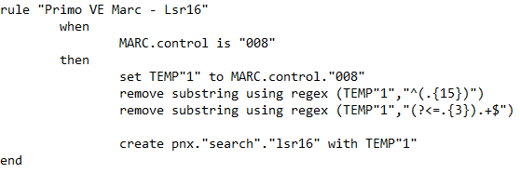
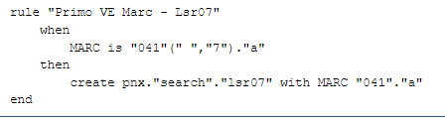
Fairly simple .... but......
041 field is recognised in the normalisation rules in Local field
008 is not recognised in the normalization rules in the same way in Local Field and requires additional steps
Credit and thanks to Thomas Guignard from Ontario Colleges Library Services who provided the normalization rules code and regex above
Notes:
the 041 field can be used directly in the normalisation rules as seen here.
I tried to do something similar for what i needed in the 008 from this example and looking at the examples on the Developer network, however it didn’t work so i put out a call for help on the EPUG list
Credit – normalization rule and the regular expressions required to extract that section of 008.
Note: regular expressions are pieces of code (symbols and characters) that allow you to find, data based on precise information or patterns in data, once found you can then remove or replace it
This takes the 008 into a TEMP field to then remove all unnecessary data before it being moved into the pnx field, and for this to be achieved, you need to use regular expressions.

Slide 11
What that reg expression does

Slide 12
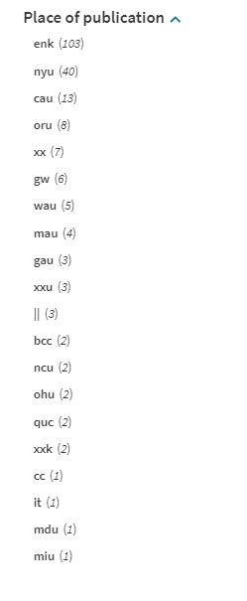
It worked!
but to make it make sense to users .....
Notes:
But this is just the code, this is where the translation table in instructions come in, you can extract from LoC 008 instructions, add to the excel template from the instructions and update in one go

Slide 13
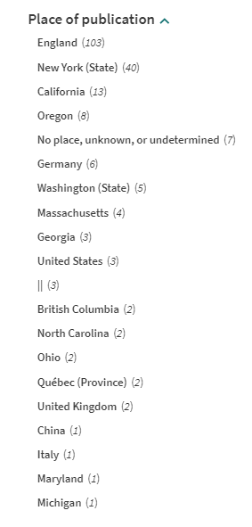
....too many entries ....too heavily weighted towards UK, USA, Canada, Australia
...... we now have useful information for users, but..........
- States (United States - 52)
- Provinces (Canada - 13)
- Territories (Australia - 10)
- Countries (UK - 5)
Notes:
In the instructions I mentioned before about granularity – this is still an issue with the locations listed in the 008 as it provides provinces in Canada, Countries in the UK, territories in Australia and states in America.
In that 20 entry list UK appears in 2 entries, Canada in 2 entries, US in 11
We needed to condense and rationalise the list

Slide 14
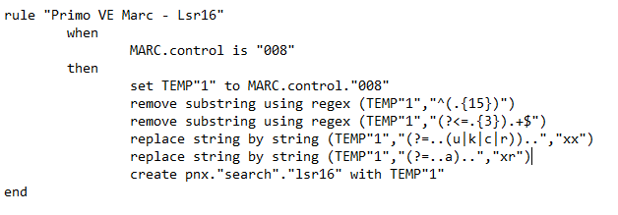
More regex!
Full list – 382 entries: https://www.loc.gov/marc/countries/cou_home.html
Notes:
repeat reg expression explanation
top 2 remove
bottom two replace – based on a pattern in information
Australia is different, and i won’t lie and say i missed that the first time i built the regular expression and had to tweak it.

Slide 15
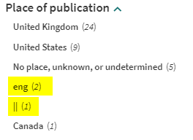
and more....
Only as good as the data you have
  eng => enk
    replace string by string (TEMP"1","eng","xxk")
  || and ___ and other errors
    Work in Progress
    Need to define what these are
Notes:
errors in data – The information we’re using is Machine Readable, but Human entered, meaning human errors.
My colleagues in Metadata wanted to minimise the instances where errors would be seen as much as possible, so … more regular expressions.
one to cover up a known error that potentially creep in: eng not enk for England
one for the use of | in the data – Still a work in progress! due to complications of | in regular expressions

Slide 16
Limitations in this approach or, why it’s not live yet and next steps
Only works for local records (MARC and DC if set up), not CDI
May cause confusion to users by either labelling or not labelling
Notes:
The limitations of this approach is that it only allows us to provide this facet for data in our local collection/from our local records and data.
Our set up in our main view of Library Search is for everything, we don’t provide scoped searching facility here. If the facet is available it would remove all CDI entries from the search without informing the users why.
We haven’t come up with a phrasing acceptable by all in our Primo Dev group that would help our users, without an appropriate label we aren’t willing to add the facet here
….. We do have a publicly available scoped search in an alternative view that we use for our special collection, it currently has an everything view but also local and again for specific collections/locations. If we remove the everything from this option – we could then release it and direct our academics at least in that direction to use the facility. but still hidden
One thing that I’ve been unable to test is whether the search slot profiles make a difference for this (if it only appears after limiting to local catalogue).

Slide 17
We almost couldn’t but now we can...
A very quick demo
– if we have time

Slide 18


Slide 19

Questions

