Slide 1

Primo Purchase Request and Resource Sharing forms
Review and implementation project
Alex Marshall, University of Leicester

Slide 2

What prompted the review?
Previously used in-house forms for both Purchase Requests and Resource Sharing requests.
Hosted on servers due to be deprecated in summer 2024.
Coded by a previous member of staff, and custom-built to the needs of the team.
Insufficient skills and knowledge to transfer the forms.
A good opportunity to review the forms and the workflows associated with them.

Slide 3
The previous forms
Resource Sharing
Purchase Request
Integrated with the university authentication service to identify and authenticate patrons.
Checked privileges and auto-filled patron details (Alma API).
Kept a log of patrons' requests and managed their quotas.
Automatically created borrowing requests in Alma (Alma API).
Sent rejected requests to a LibAnswers queue.
Integrated with the university authentication service to identify and authenticate patrons.
Checked privileges and auto-filled patron details (Alma API).
No integration with Alma.
Sent all requests to a LibAnswers queue.
Alma Purchase Request module not used.

Slide 4

Our options
Microsoft / Google forms
Primo forms
Current structure of forms can be replicated
No integration with Alma
Issues with authentication
Issues with limiting access
No quota management
Loss of existing functionality
At point of need
Authentication is handled by Primo
Access is handled by Primo
Integration with Alma (workflow automation)
Quota management
Current structure of forms cannot be replicated

Slide 5
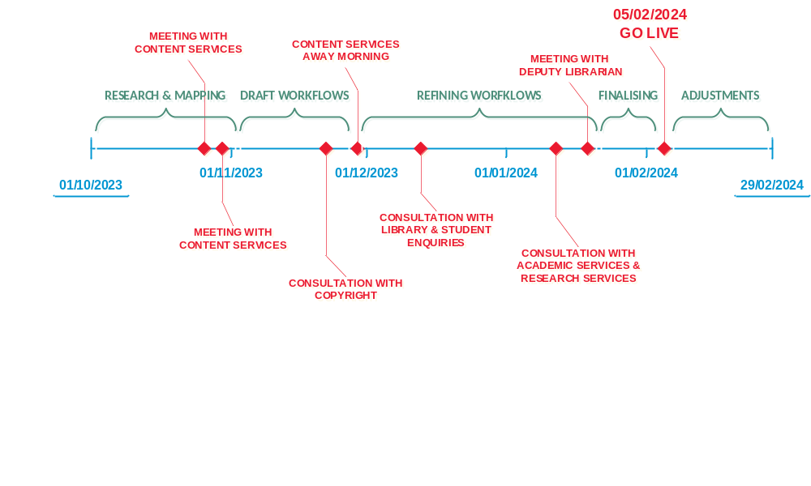
Project timeline

Slide 6

Primo

Slide 7
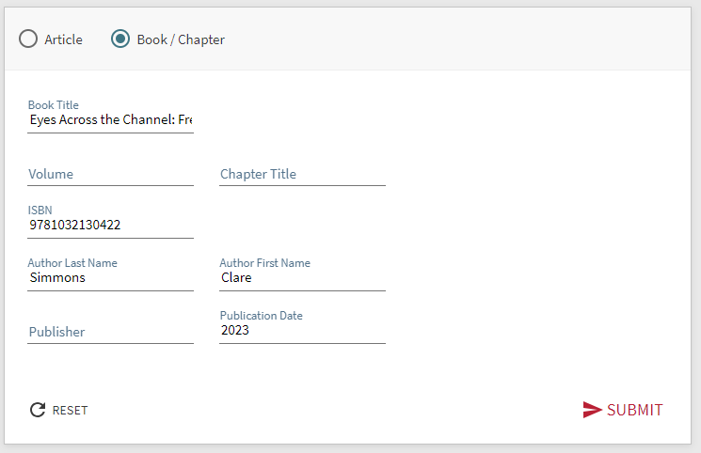
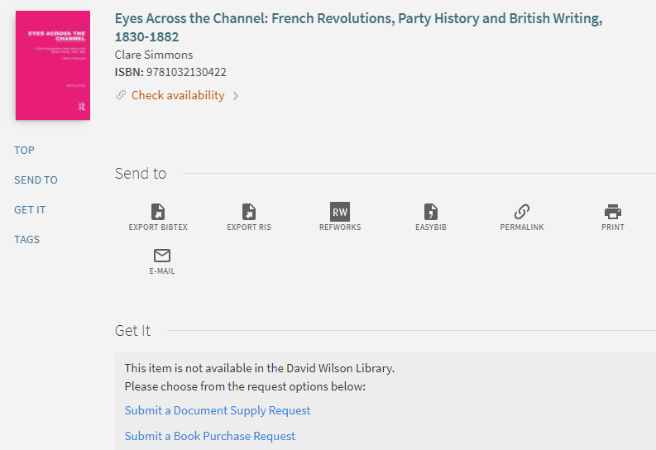
Citation Linker (Fetch Item)
One entry point for both services
“Stock checking”
Can link to Citation Linker on external resources (Library website, FAQs etc.)

Slide 8
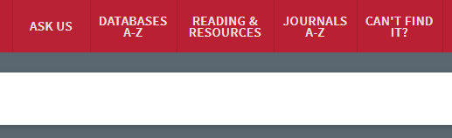
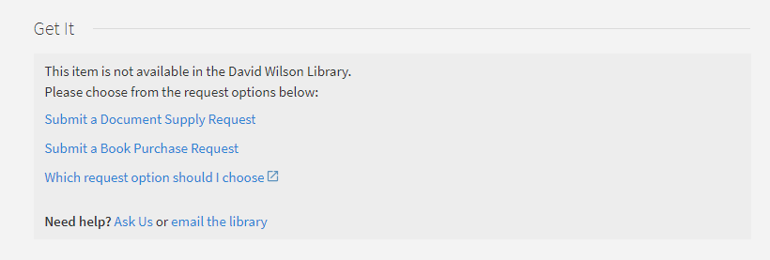
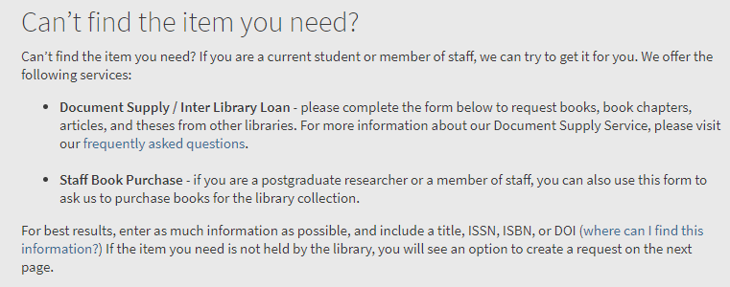
1. Citation Linker confusion
Issues:
Confusion about the two services appearing together.
Confusion about how the Citation Linker works.
= Not intuitive
Solutions:
Can’t Find It? – a name that encompasses both services.
Added a “Which request option should I choose?” General Electronic Service.
Customised the help text on the Citation Linker page to make it clear which services are available.
Move the Send To actions further down the page.

Slide 9
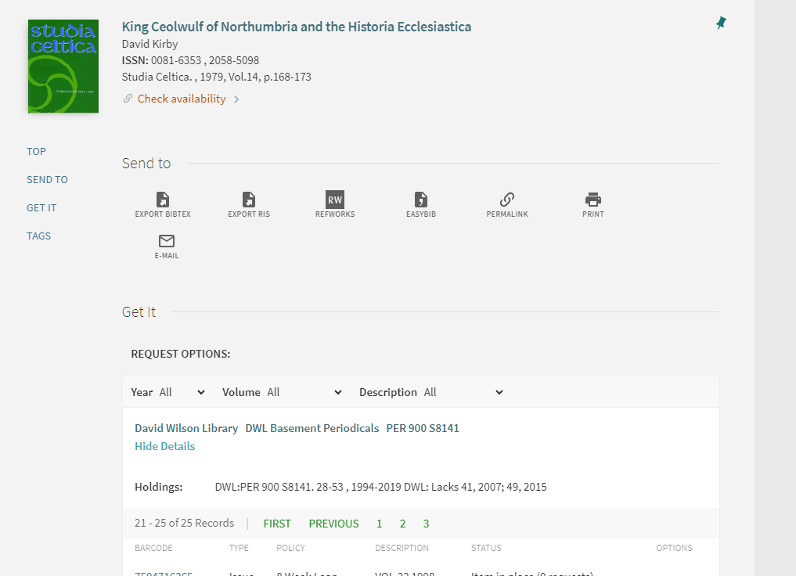
2. Citation Linker matching issues
Issues:
Incorrect matching to different editions.
Incorrect matching to different journal issues.
= The patron becomes “trapped”.
Solutions:
Manual requests are placed for patrons (Copyright Declaration must be signed for ILLs).
Tweak the Display Logic Rules.

Slide 10
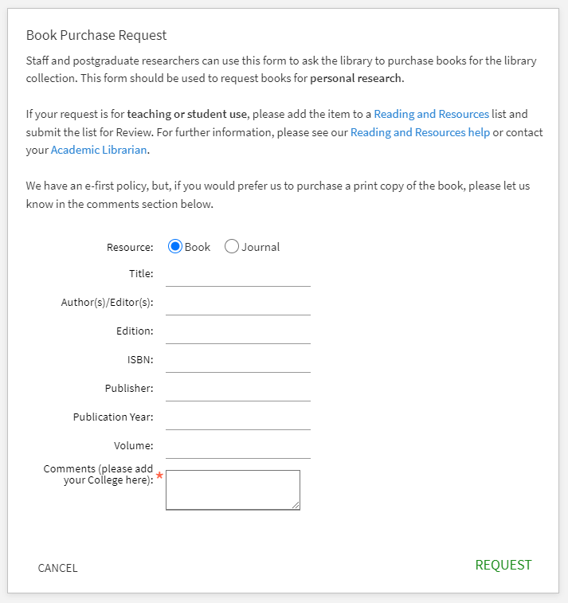
3. Limited customisation
Issues:
Limited options for custom fields in both forms.
No form description field to instruct patrons to include key information.
= Required information can’t be collected.
Solutions:
Stopped collecting non-essential information.
Removed the option to request books for reading lists from the Purchase Request form.
Amended the form header to include information about this change and formatted the text with CSS.

Slide 11
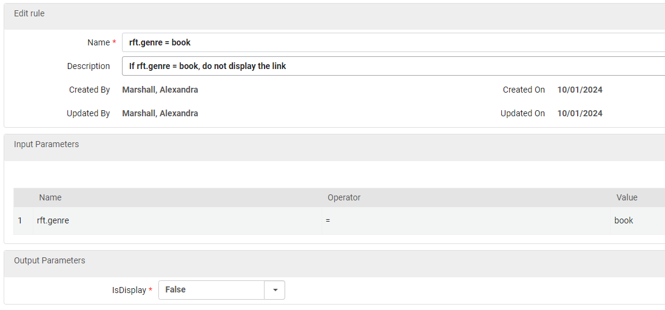


4. Limitations of Display Logic Rules
Issues:
Not possible to configure a rule to prevent the Purchase Request option from appearing on journals.
Citation type ‘Journal’ cannot be removed from the Citation Linker or the Purchase Request form.
= Purchase requests for journals, which we cannot fulfil.
Solutions:
Fudged the Display Logic Rules so the Purchase Request option only appears on books.
Used CSS to hide the citation type ‘Journal’.

Slide 12

Alma

Slide 13
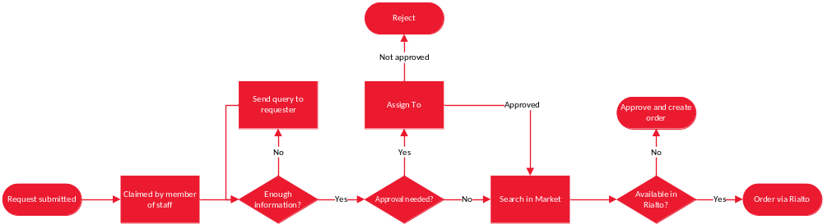
Purchase Request workflow (simplified)

Slide 14
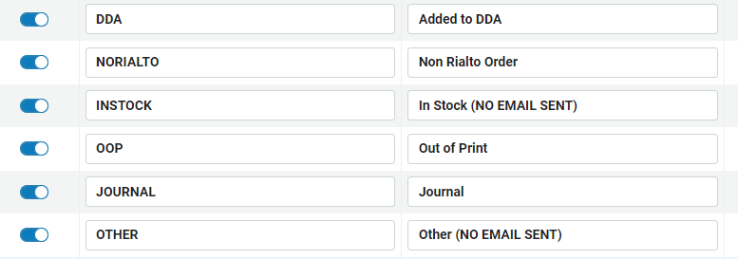
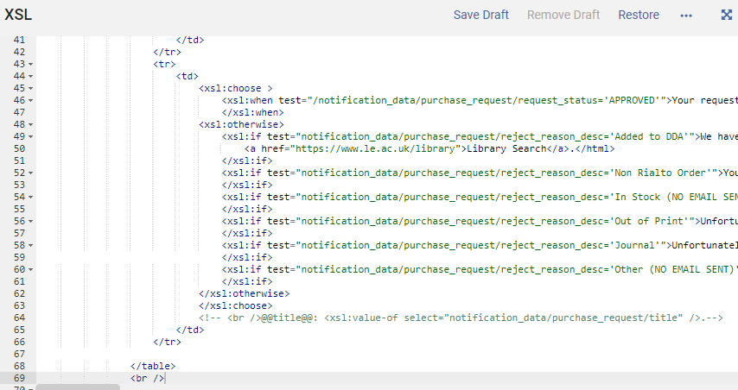
1. Limited approval options for Purchase Requests
Issues:
A POL is always created when a Purchase Request is approved. Not suitable for EOD, importing from Community Zone, DDA etc,.
Order templates cannot be applied to manual POLs created from a Purchase Request.
= Non-Rialto orders are difficult to process.
Solutions:
Requests are “rejected” and ordered separately.
Added custom reject reasons and amended the XSL of the Purchase Request Letter to send appropriate canned responses the patron.

Slide 15
Purchase Requests stats
February, March and April 2024
66% of requests were rejected.
87% of rejected requests were ordered elsewhere.
72% of rejected requests were added to DDA.
Request status | No. of requests | %
Rejected | 98 | 66%
Approved (Rialto) | 43 | 29%
Cancelled | 5 | 3%
In Rialto User List | 1 | 1%
Approved (manual) | 1 | 1%
TOTAL | 148
Reject reasons | No. of requests | %
DDA | 70 | 72%
Other supplier | 15 | 15%
Other | 8 | 8%
Out of print | 3 | 3%
In stock | 2 | 2%
TOTAL | 98

Slide 16
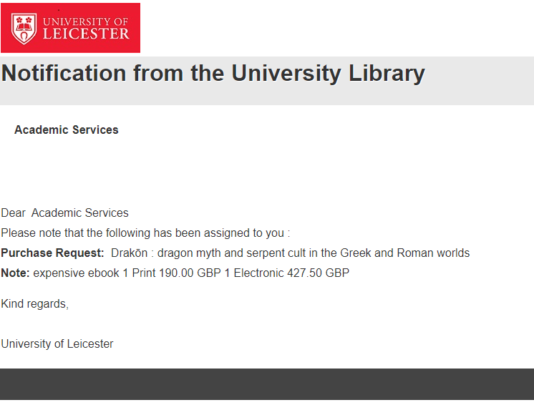
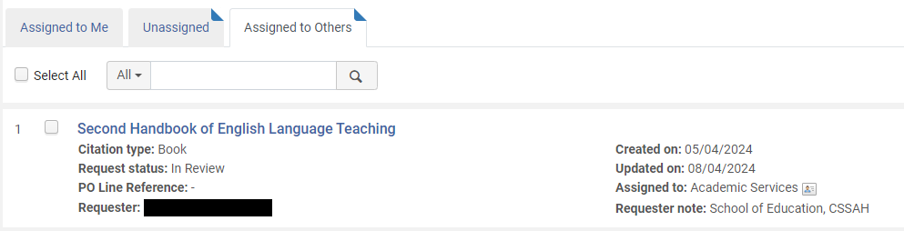
2. Assign To workflow
Issues:
Our Academic Services team do not use Alma.
The General Assign To letter contains very little information.
Requests need to be assigned to teams, rather than individuals.
= Difficult to assign requests between colleagues.
Solutions:
Requests are assigned to a dummy account in Alma. The Assign To email is forwarded to a LibAnswers queue.
Relevant information is copy/pasted into the notes field when assigning the request, or is added to the LibAnswers ticket.

Slide 17
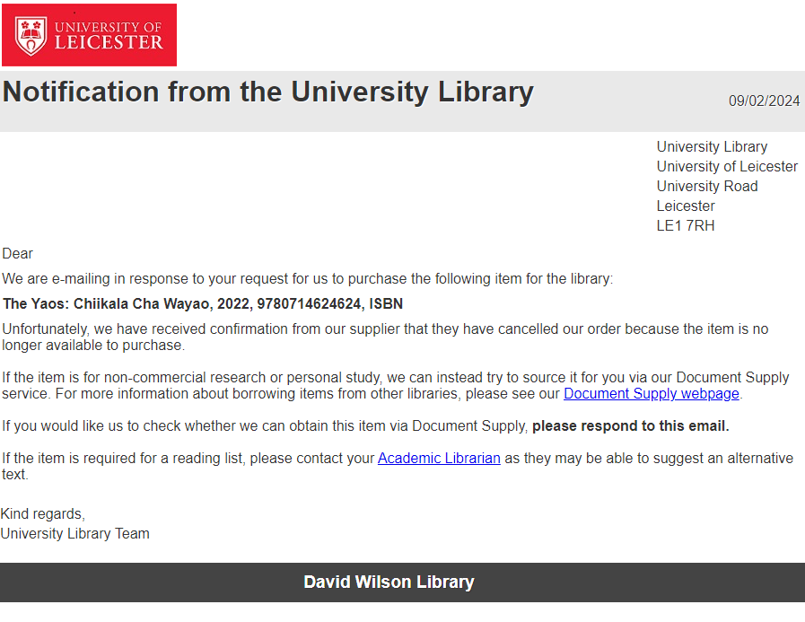
3. Unable to re-open or convert requests
Issues:
If an order is cancelled by the supplier, it is not possible to re-open the request.
It is also not possible to convert Purchase Requests to Resource Sharing requests.
= Duplication of work and need to manually contact the patron.
Solutions:
Use of “Notify Upon Cancellation” in Interested User options.
Amended the XSL in the Interested In email to include a custom response for this circumstance.

Slide 18
Positives
Despite the challenges, the project has been a success.
There are a lot of positives to using the Primo forms:
  Primo
  Resource sharing requests +8% (Feb-Apr)
  Purchase requests +26% (Feb-Apr)
  Requesting at point of need.
  Citation Linker reduces requests for in stock items.
  Alma
  Purchase Request Rialto workflow is relatively seamless.
  Less duplication of work in LibAnswers.
  Patron communications all managed in Alma.
  Improved analytics.

Slide 19
If you have some votes to spare…
Ex Libris Ideas Exchange
Control Purchase Request display in Primo by material type.
Add to the Purchase request's "Approve and Order" action an option to select a PO line template.
Analytics reports for deleted purchase requests.
Purchase Request conversion into a Resource Sharing Request.
Already accepted:
Improve the e-book Purchase Request workflow.
Add an order action in the Purchase Request to “Approve and order from the CZ”.

Slide 20
Thank you!
am1441@leicester.ac.uk
Photography by Design Services, University of Leicester

